Slide 1

Energy Production In A Combined-cycle Power Plant
PROJECT TITLE: “ENERGY PRODUCTION IN
A COMBINED-CYCLE POWER PLANT ”
MENTOR NAME: Mr. Karthik Muskula
GROUP NO.: 4
START DATE: 29 AUG 2023

Slide 2
Group details
MR. SRIHARSHA NOORBHASHA | sriharsha.nsh02@gmail.com | 9959905437
Mr. Akshay haridas rautray | akshayrautray6@gmail.com | 9637637670
Ms. Jayshree Ramesh Bhoyar | jayashribhoyar27@gmail.com | 9146611282
Ms.Devangam Ramya | ramyad7799@gmail.com | 9573448642
Mrs. Afrin Fathima Abulkalam Azath | afrinazath@gmail.com | 971 558554503 (UAE number)
Vrushali Laxman Bagul | vrushibagul.96@gmail.com | 9175057012
Ms.Ashwini Eknath Jadhav | jadhavashwini4454@gmail.com | 9373287718

Slide 3
Business Objective:
A combined-cycle power plant comprises gas turbines, steam turbines, and heat recovery steam generators. In this type of plant, the electricity is generated by gas and steam turbines combined in one cycle. Then, it is transferred from one turbine to another. We have to model the energy generated as a function of exhaust vacuum and ambient variables and use that model to improve the plant's performance.

Slide 4
Business Problem
To develop a predictive model to predict full-load power output in a combined-cycle power plant.
Evaluate the performance of the model
Since the goal is to predict the output power based on some parameters, this is a regression problem. Regression aims to establish a relationship between predictors (variables that help us make a prediction) and the target (the value we want to predict).

Slide 5
Project Architecture / Project Flow
Understanding the Business Problem
Dataset Understanding
EDA process
Feature Engineering
Model Building
Model Evaluation and Feedback
Deployment

Slide 6
Data Set Details:
In this project variable to be predicted is energy production
The data file contains 9568 observations with five variables collected from a combined cycle power plant over six years when the power plant was set to work with a full load.
The variables, or features, are the following:
temperature, in degrees Celsius.
exhaust_vacuum, in cm Hg.
amb_pressure, in millibar. (Ambient pressure)
r_humidity, in percentage. (Relative humidity)
energy_production, in MW, net hourly electrical energy output.
Independent Variables
Dependent Variables

Slide 7
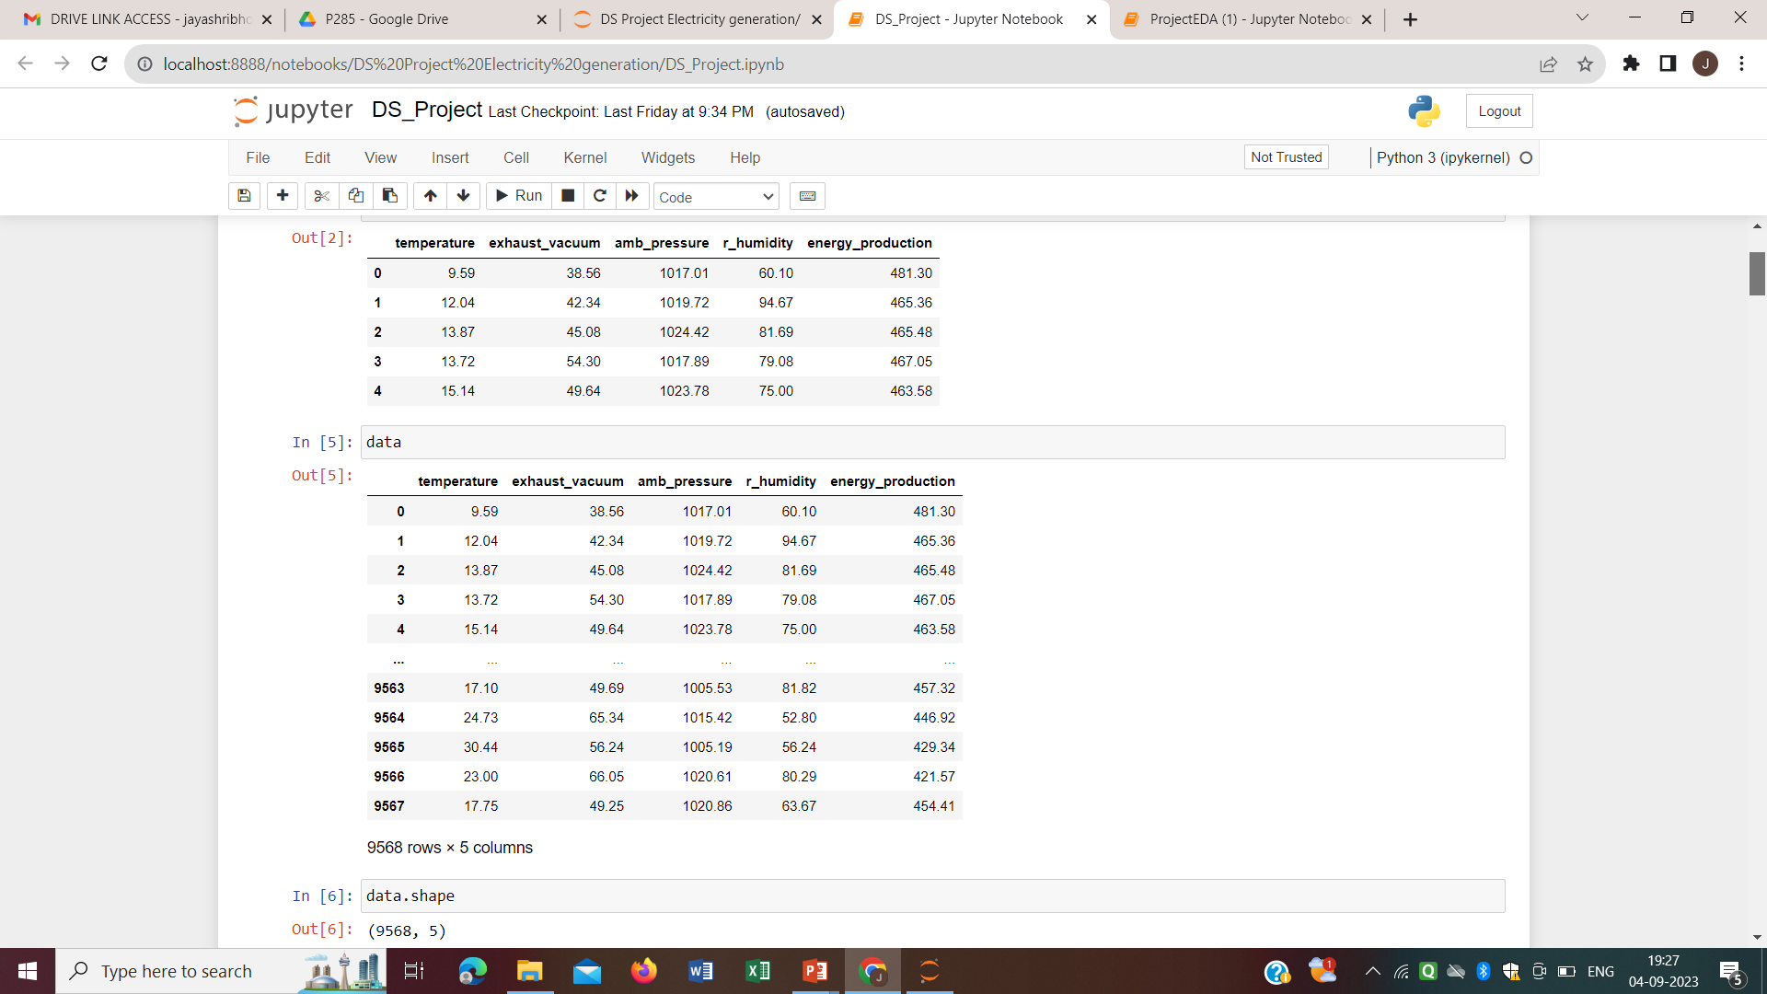
Data Set

Slide 8
Exploratory Data Analysis (EDA) and Feature Engineering

Slide 9
In the given dataset the datatype of the observations in each variables are floating point datatypes.
In data set each features contain non-null values.
There are total 41 duplicate observations present in dataset, and that has been removed.
Now the cleaned dataset contain 9527 observation and 5 features.
From the Statistical Summary
Ambient Temperature in the range 1.81°C and 37.11°C,
Ambient Pressure in the range 992.89 – 1033.30 millibar,
Relative Humidity in the range of 25.56% to 100.16%
Exhaust Vacuum in the range 25.36 – 81.56 cm Hg
Net hourly electrical energy output 420.26 – 495.76 MW

Slide 10
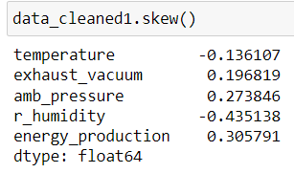
Data Distribution:
temperature and r_humidity – Negatively Skewed or left Skewed
exhaust_vacuum, amb_pressure, and energy_production - Positively Skewed or Right Skewed.

Slide 11
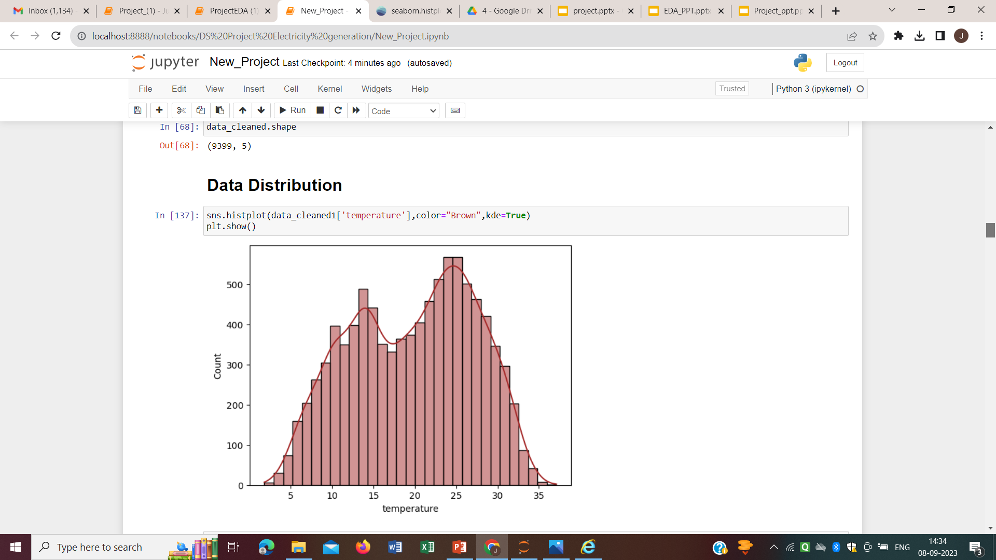
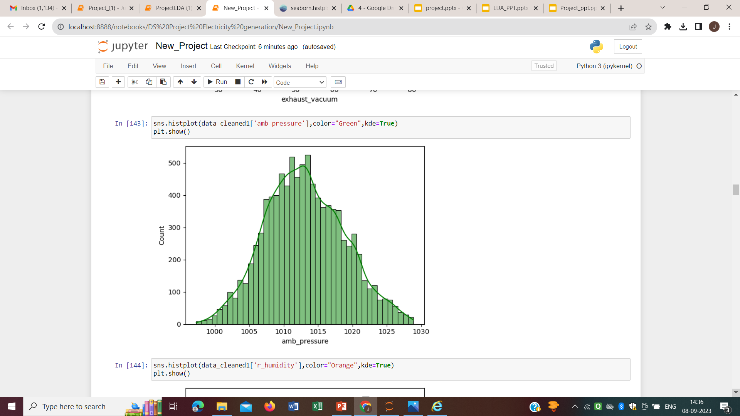
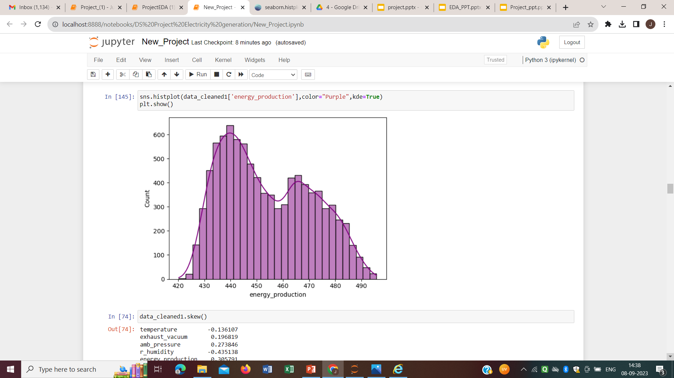
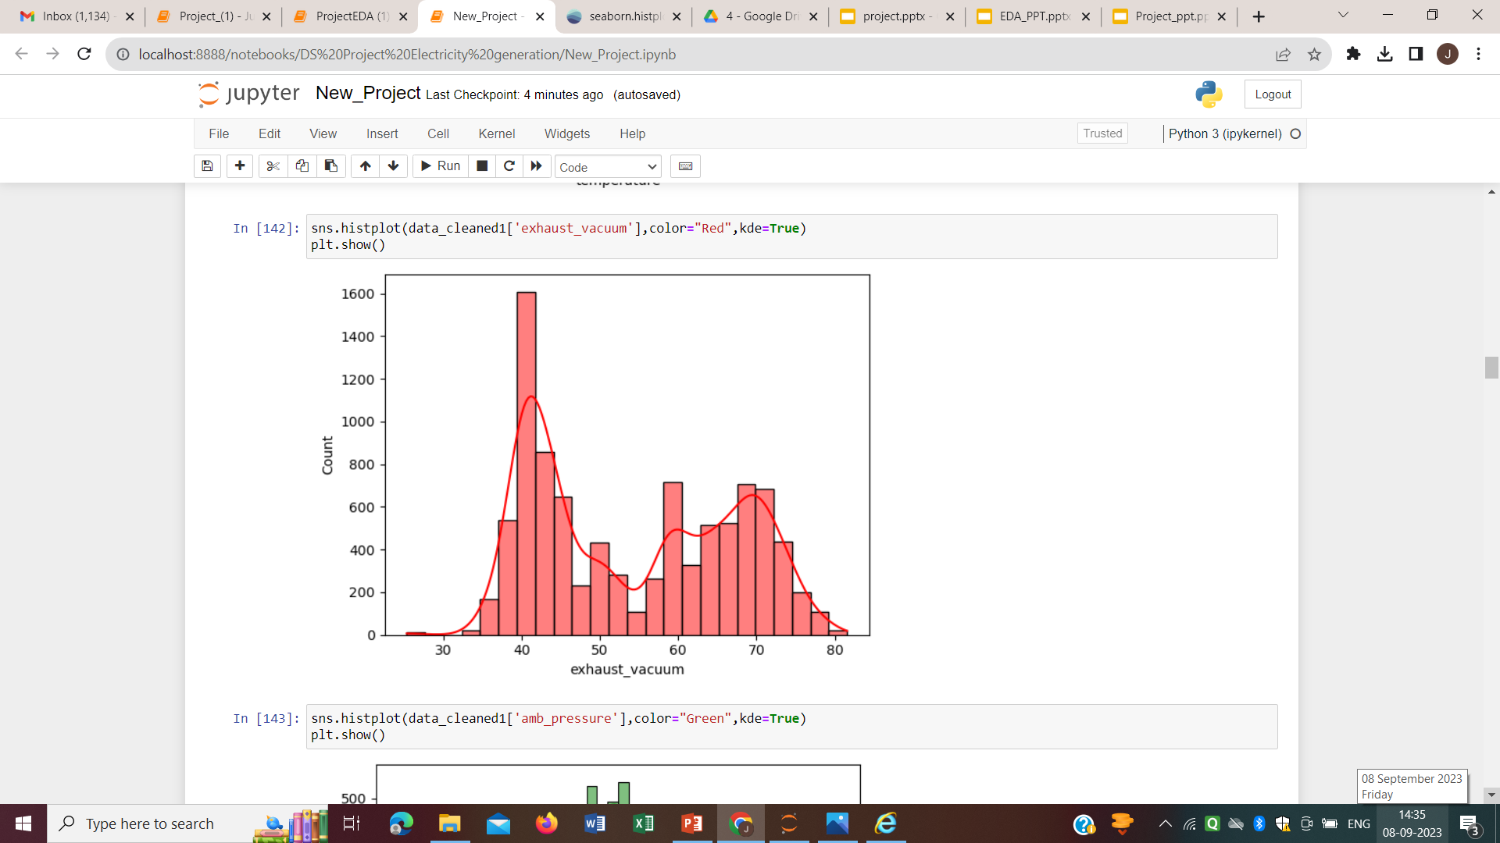
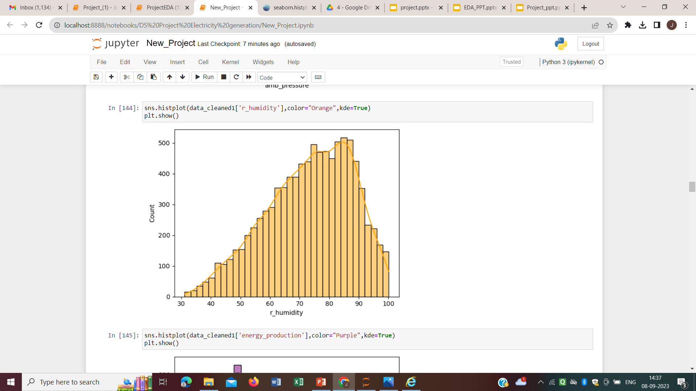

Slide 12
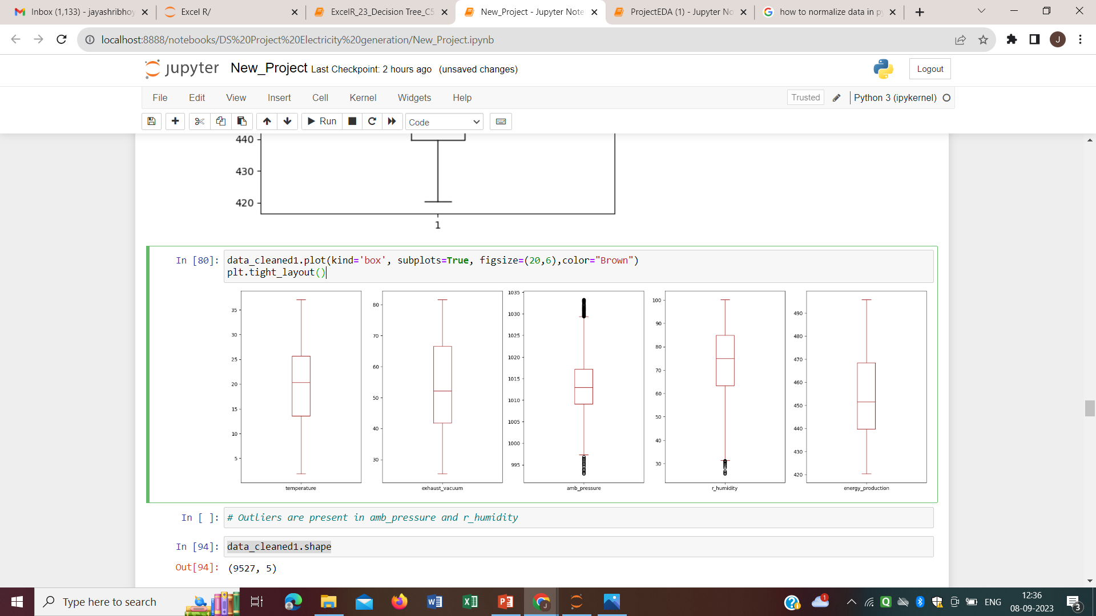
Outlier Detection: Outliers were present in amb_pressure and r_humidity
Box Plots of Variables before removing the outliers

Slide 13
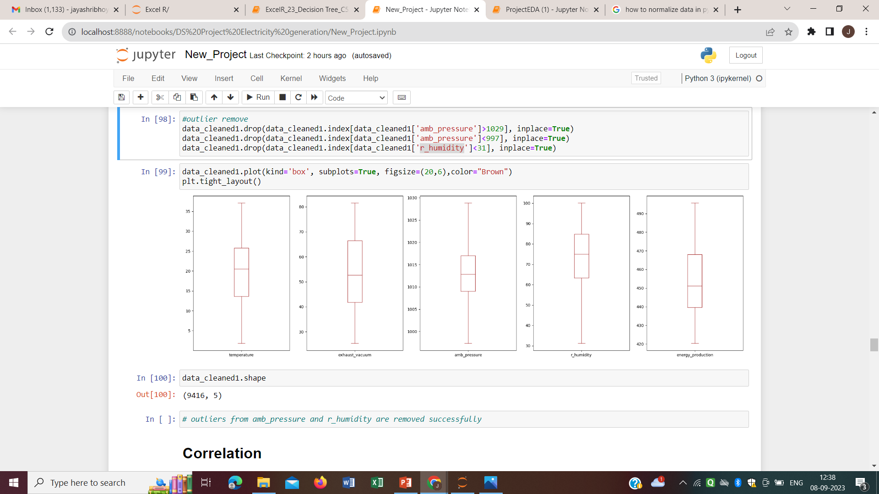
outliers were removed successfully. Now the dataset contain 9416 observations and 5 features.
Box Plots of Variables after removing the outliers

Slide 14
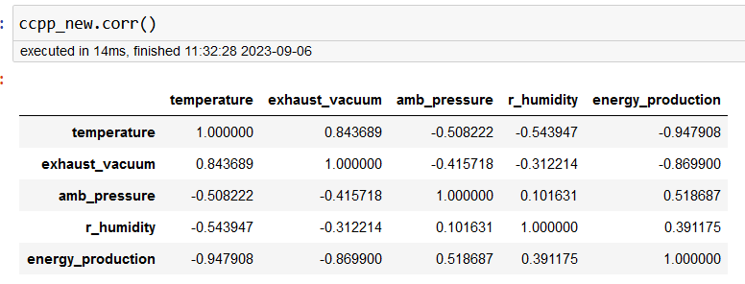
Correlation Matrix
A correlation matrix is a structured approach to ranking the importance of predictors or input variables (input variables that have the most impact) on the output. To do this we plot the heatmap of the correlation matrix using Seaborn.
Correlation is measured on a scale of -1 to 1. -1 means complete negative correlation and 1 means complete positive correlation. 0 means no correlation at all.

Slide 15
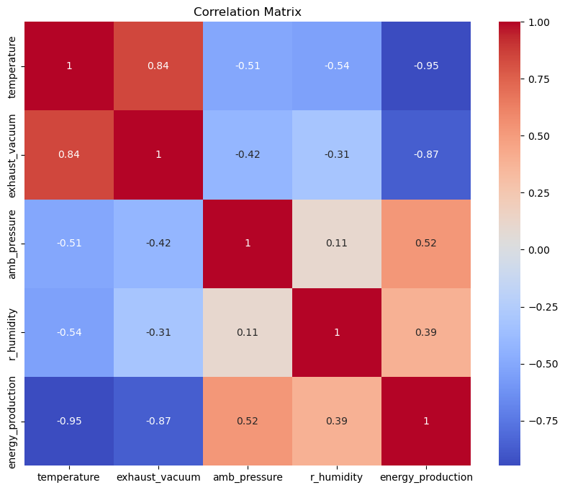
From the correlation matrix, we can see that temperature and exhaust_vaccuum have a strong negative correlation with the target variable (EP) as their correlation coefficients are -0.95 and -0.87 respectively.
Amb_pressure and r_humidity have a weak positive correlation with energy_production with correlation coefficients of 0.52 and 0.39.

Slide 16
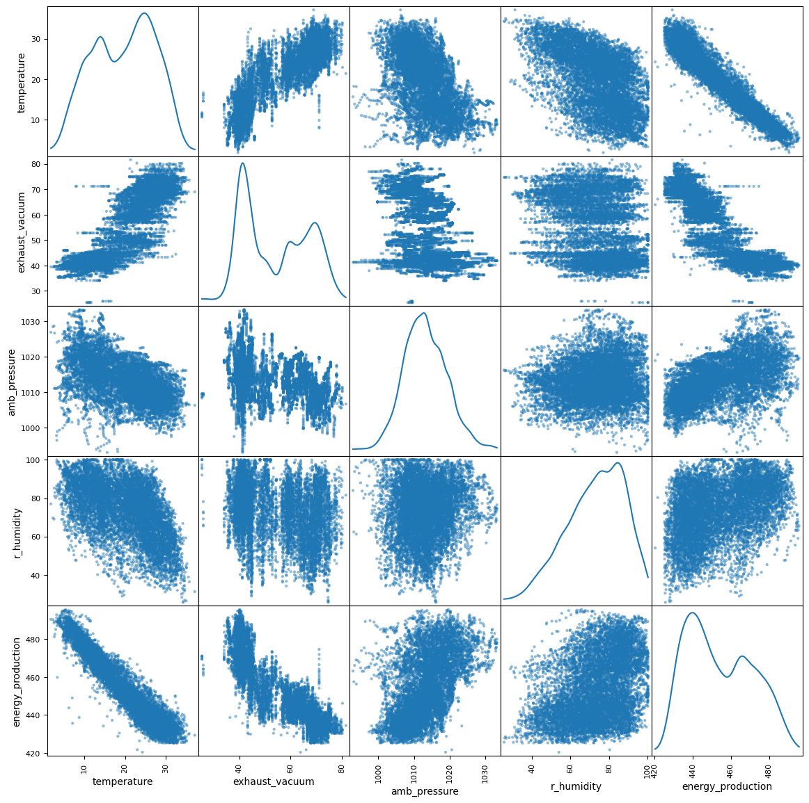
When visualized we can easily see that there is a distinctive pattern (negative correlation) seen on temperature and exhaust_vacuum in relation to energy_production. We can also notice that temperature and exhaust_vacuum are highly correlated with each other. This is usually not a good thing as our features should be independent of each other. This problem is called multicollinearity. One way of solving this problem is to select the feature(s) that more strongly correlates with our target variable (energy_production). In this case that will be temperature (-0.95). In some cases, we can choose to live with the problem and use our features like that.

Slide 17
Normalization: Normalization of data is carried out to bring all the observations on same scale.
Splitting the data set:
1. X – independent variables and Y- dependent variable
2. Data is splitted in Train and test
Train dataset- containing 7532 observations and 4 variables
Test dataset- containing 1884 observations and 4 variables

Slide 18
Feature Engineering
The initial observation of the data suggests that we will need to use a linear regression model to predict the power output.
Though we have obtained a linear model earlier using the statsmodel library, it was a simple mathematical derivation using the data.
The actual observed value is 481.30, which is not very far from the predicted value 480.27
Now will use the sklearn library, which provides different machine learning models.
Feature Selection :
One of the most important steps in creating a machine learning model is to divide the data set into good predictors to train the algorithm on.

Slide 19
Model Building

Slide 20
Those selected features are trained on below regression models,
1. Linear Regression
2. Decision Tree Regression
3. Random Forest Regression
4. Ridge Regression
5. Lasso Regression
6. ElasticNet Regression
7. XGBoost Regression
8. Gradient Boosting Regression
9. Support Vector Regression
10. AdaBoost Regression
11. KNN

Slide 21
Model Evaluation
For Regression problems, there are 3 key performance metrics that are used to assess how well your model is performing. There are
Root Mean Squared Error (RMSE): measures the average error performed by the model in predicting the outcome for an observation.
R-Squared: It means how much of the variation in the target variable that can be explained by the set of features used in training the model.
Mean Absolute Error: measures how far predicted values are away from the actual values.

Slide 22
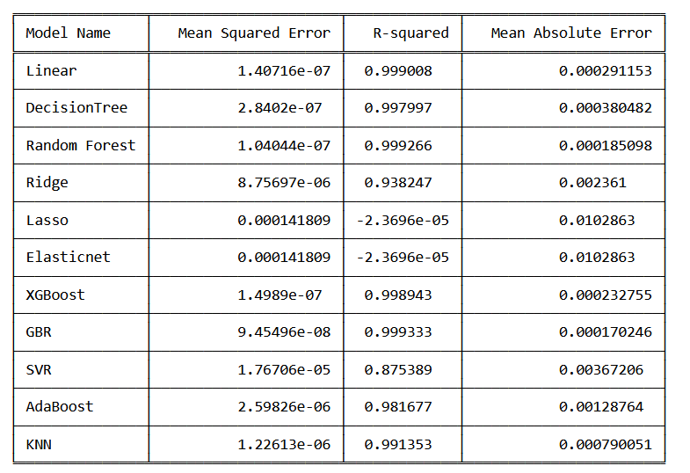
Performance metrics

Slide 23
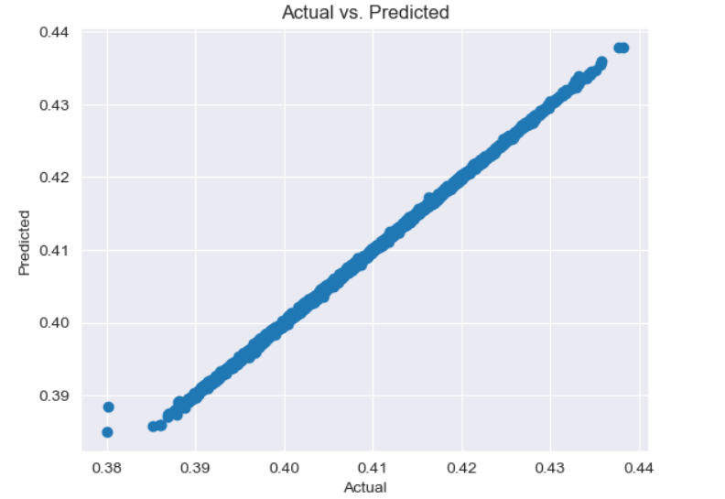
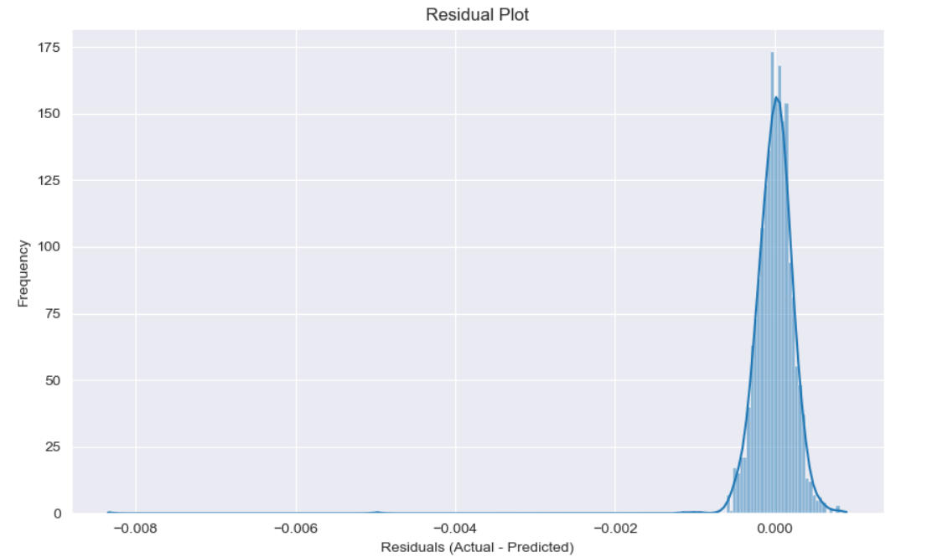
Plotted the value from Gradient Boosting Regression

Slide 24
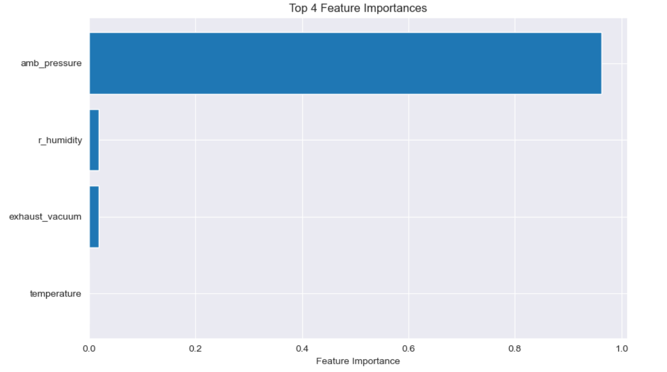

Slide 25
Model Results
Now that we have evaluated all our models, we can see that the Gradient Boosting Regression Algorithm (with all features) gave us the best performance.
The R-squared is 0.999333 (which means that 99.93% of the variation in the target variable can be explained by the model).
Similarly, it yields the lowest MSE of 9.45496e-08.
We can conclude from our results that Gradient Boosting Regression should be selected as best regression model to predict future values.

Slide 26
Deployment of Model

Slide 27
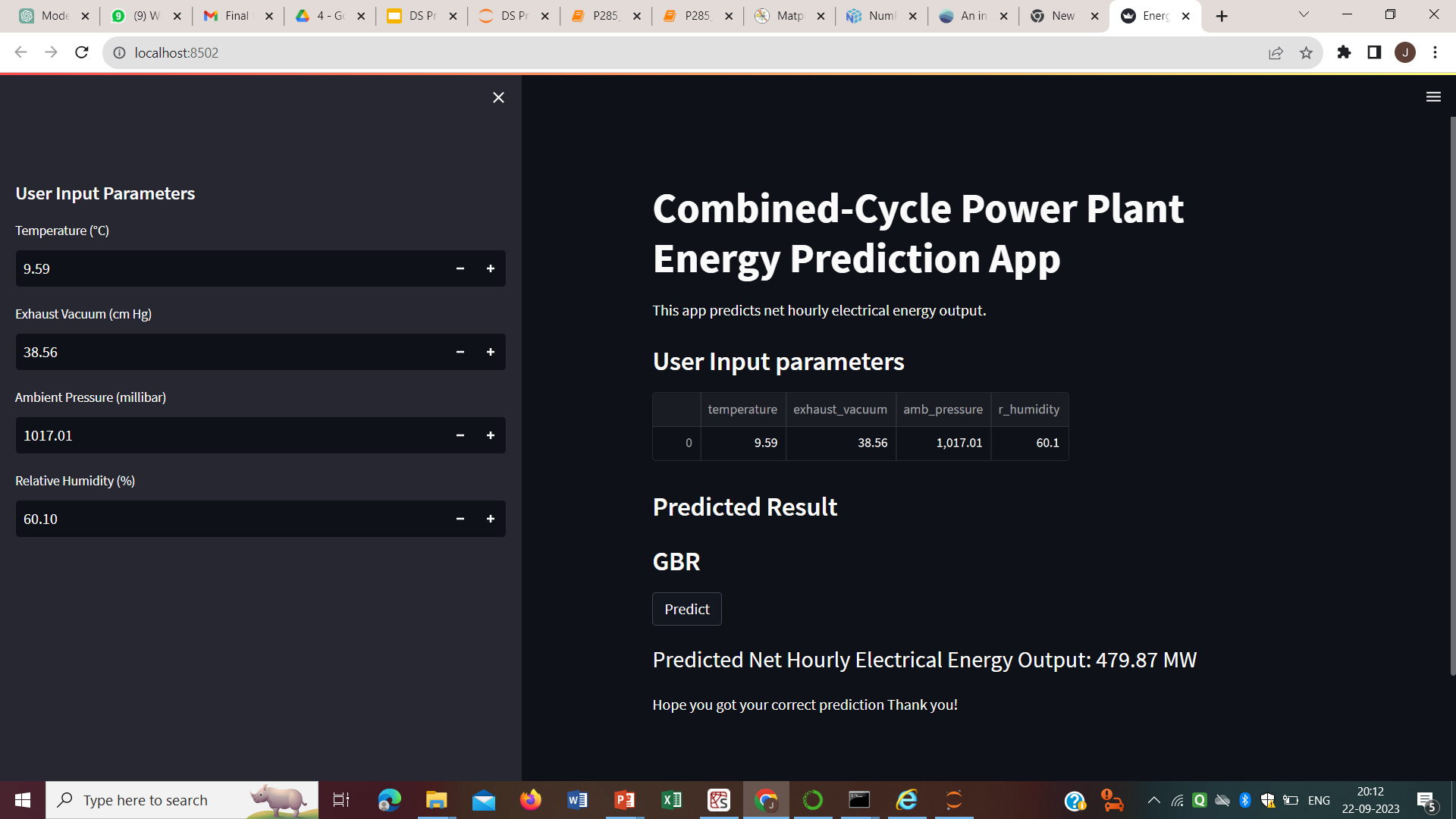
Deployment of Gradient Boosting Regression model by using Streamlit.

Slide 28
Challenges
Removing the outliers :Outliers can negatively affect the performance of machine learning models by introducing noise or causing convergence issues in the model performance.
Feature Selection: Choosing the right variables (features) to include in our model was crucial. Selecting irrelevant or redundant features could negatively impact the model's performance.
Model Selection: Deciding which Regression algorithm to use for predicting energy production was a challenging task. Different models have different strengths and weaknesses.
Hyperparameter Tuning: finding the best set of hyperparameters for a given algorithm or model to achieve optimal performance.
Deployment: Integrating our model using streamlit, ensuring it runs reliably in real-time, and make it user friendly.

Slide 29
References
1.https://pandas.pydata.org/
2.https://numpy.org/doc/
3.https://matplotlib.org/
4.https://seaborn.pydata.org/
5.https://scikit-learn.org/
6.https://www.statsmodels.org/

Slide 30
Thank You

